Slide 1
Case Scenario: Center Time at the Fireflies Classroom
PR002: Play and Learning for Preschoolers
Notes:
Note: All included images are have royalty-free licenses.

Slide 2
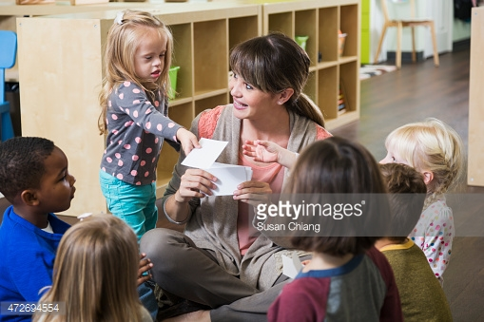
Rosa is a lead teacher at the Morningside Early Learning Center. Her preschool class, the Fireflies, has 20 children ranging in age from 3 to 4 years old. At the Fireflies classroom, the daily morning meeting is almost over. Rosa gives Mary, her classroom helper for the day, a card and smiles encouragingly. Mary looks carefully at the card, which has the name and photo of one of her classmates.
“Kayla, please choose a center,” Mary says as she holds the card out.
Kayla gets up and brings her card to a wall chart that displays a list of the classroom centers. After a moment, she places her card on the chart next to the label for Nature and Science.
After everyone has chosen their centers, Rosa smiles at Mary. “Thank you for helping me lead our morning circle today. Fireflies, you may go to your centers.”
Notes:
http://www.gettyimages.com/license/472694554
Creative #: 472694554

Slide 3
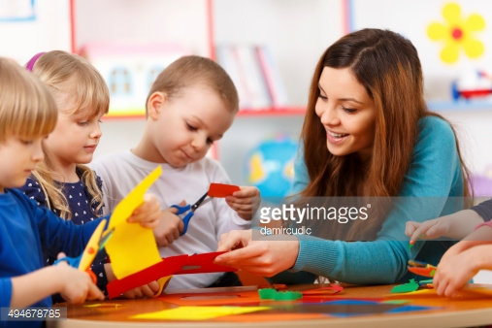
Soon, the classroom is buzzing with conversation and activity. Rita, an assistant teacher, kneels down by the art center . “What are you making, Marc?” she asks.
Marc replies, “A tomato. I’m making a garden.”
Ava grins and holds up a yellow circle. “I’m making a garden too! This is a yellow tomato.”
Marc frowns. “Tomatoes can’t be yellow! They’re red.”
“No, tomatoes can be yellow! My mom gave me small yellow tomatoes,” Ava insists.
“Ava is right,” Rita says. “Tomatoes can be red, yellow, orange, or even green.”
“Really?” Marc picks up some yellow paper. “My garden has yellow tomatoes too,” he says. “And orange tomatoes.”
“Great! What else can we put in our gardens?” Rita asks them.
Notes:
http://www.gettyimages.com/license/494678785
Creative #: 494678785

Slide 4
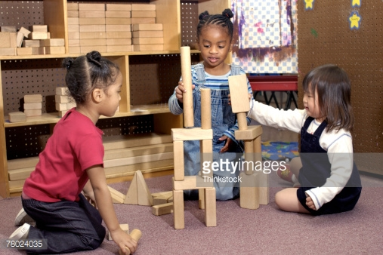
Over at the blocks center, Cherry tries to stack several thin blocks on top of each other but they fall down. She looks carefully at Lisa’s tall tower and puts two square blocks together as a base, just like hers. Mariah sits nearby and watches Cherry and Lisa.
Notes:
http://www.gettyimages.com/license/78024035
Creative #: 78024035

Slide 5
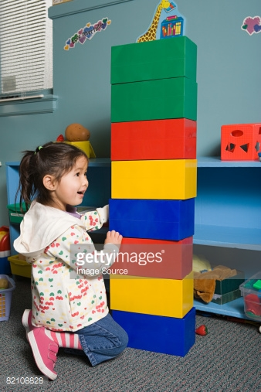
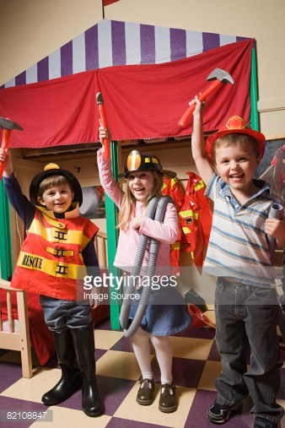
Rosa observes the dramatic play center with interest. She had placed several large blocks in the center this morning to see how the children would use them in their play. She notices that Kimiko has stacked them together. Nearby, Luis, Amy, and Martin have dressed up like firefighters.
“Are you going to help someone?” Rosa asks them.
“Yeah!” Luis shouts. “The baby cat.”
“Meow!” Kimiko calls from behind the blocks.
“I see! You’re going to help the kitten because she can’t get down from the tall tree,” says Rosa.
“Yeah, the kitten,” Luis replies. “She can’t get down from the tree.”
“I want to play house,” Martin says, and starts to take off his hat.
“No, first we have to go to work. Then we can go home and eat dinner,” Amy explains.
“Okay,” Martin agrees. “But I want to cook the dinner.”
Notes:
http://www.gettyimages.com/detail/photo/girl-with-building-blocks-royalty-free-image/82108828
Creative #: 82108828
http://www.gettyimages.com/license/82108847
Creative #: 82108847

Slide 6
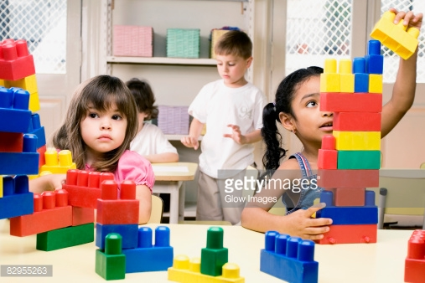
Carmen and Aaliyah are both sitting together and playing with blocks but Rosa notices that they aren’t talking to each other. Carmen removes a yellow block and puts it on the table. Aaliyah picks it up.
Notes:
http://www.gettyimages.com/license/82955263
Creative #: 82955263

Slide 7
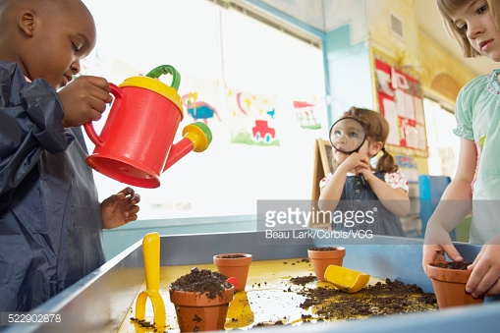
Rita sits near the Science and Nature center to supervise play. She and Rosa had decided to add soil to the center because they are studying gardens and vegetables this week. She hears Darren say to himself, “The flower needs to drink water,” as he pretends to pour from a watering can.
Notes:
http://www.gettyimages.com/license/522902878
Creative #: 522902878

Slide 8
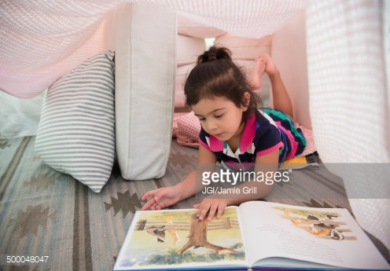
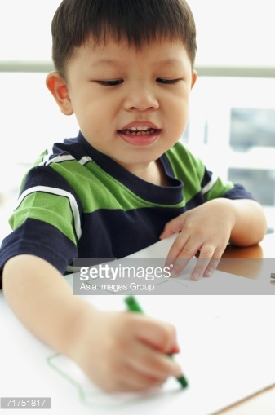
A few children are playing alone. Sonya has brought a book with her to a quiet corner of the classroom that has several soft cushions. Ping is intently scribbling with crayons. Rosa quietly observes them and decides not interrupt them.
Notes:
http://www.gettyimages.com/license/500048047
Creative #: 500048047
http://www.gettyimages.com/detail/photo/young-boy-with-crayon-drawing-royalty-free-image/71751817
Creative #: 71751817

Slide 9
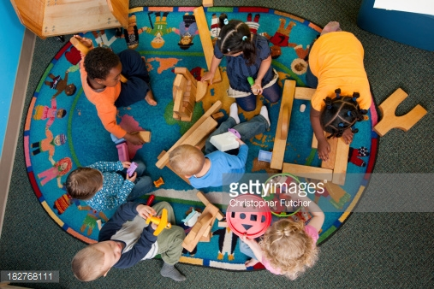
After 45 minutes have passed, Rita comes over to Rosa. “The children are really focused today, especially over at the dramatic play center,” she tells her. “The group from the blocks center joined them to build a restaurant. I think we should let them play longer.”
Rosa nods. “That’s a great idea. Let’s extend this to 75 minutes. It’s pretty cloudy too, so we’ll make outdoor play time a bit shorter instead.”
Notes:
http://www.gettyimages.com/detail/photo/babies-sitting-on-floor-together-royalty-free-image/150638308
License type: Royalty-free
Creative #: 150638308

Slide 10
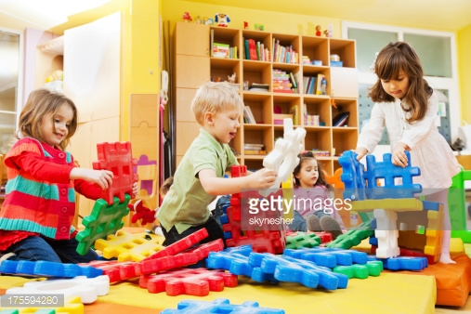
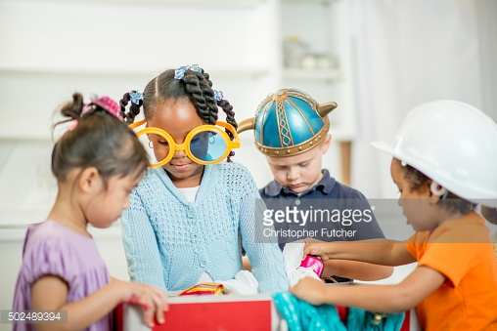
As Rosa looks around the classroom, she smiles at all the learning taking place in front of her. It is abundantly clear to her why play is so important for her preschoolers’ development and learning. However, how can she communicate that more clearly to her students’ families?
Several parents have recently voiced their concerns about how much their children are playing at school. There is very little pencil-and-paper type of work. They wondered why their children aren’t spending more time learning their letters, numbers, colors, and shapes so they can be ready for kindergarten. Perhaps she could make a newsletter or brochure to share with the families.
Notes:
http://www.gettyimages.com/detail/photo/children-stacking-blocks-royalty-free-image/175594280
Creative #: 175594280
http://www.gettyimages.com/detail/photo/children-playing-dress-up-together-royalty-free-image/502489394
Creative #: 502489394

